Slide 1

SUPPLY and DEMAND

Slide 2
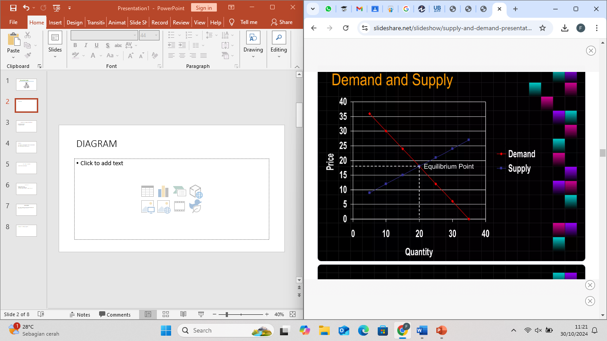
DIAGRAM

Slide 3
Demand and Supply Relationship
Buyers determine demand
Sellers determine supply

Slide 4
Demand
The quantity of a good or service that buyers will purchase at various prices during a given period of time
The quantity of demand depends on the price

Slide 5
The Law of Demand
there is an inverse relationship between price and quantity demanded.
The higher the price, the lower the level of demand.

Slide 6
Factors Affecting Demand
Income: Higher income can increase demand for goods and services
Consumer Preferences: Changes in tastes or preferences can increase or decrease demand for specific products.
Price of Related Goods: The demand for a product can also be influenced by the price of substitutes or complements

Slide 7
Supply
Supply is the amount of a good or service that producers are willing and able to sell at various price levels

Slide 8
The Law of Supply
there is a direct relationship between price and quantity supplied
The quantity supply will increase if price increases and fall if price falls, as long as other things do not change.

Slide 9
Factors Affecting Supply
Production Costs: Higher costs (e.g., for raw materials or labor) can reduce supply, shifting the supply curve leftward.
Technology: Advances in technology can increase supply by making production more efficient.
Number of Suppliers: An increase in the number of suppliers generally increases the supply of a product in the market

Slide 10
Equilibrium Price
demand matches supply
acceptable to buyers and sellers
balancing quantity of the goods in supply and demand

Slide 11
Shifts in Supply and Demand
Demand Shifts: If a factor like consumer income changes, it may shift the demand curve left
(decrease in demand) or right (increase in demand).
Supply Shifts: Changes in production costs or regulations can shift the supply curve left (decrease in supply) or right (increase in supply).

